Slide 1

Task: Realtime Prices of Elements WebApp
Presented by : RAJ PARKHI
VAIBHAV NIRMAL
AMEY DHOLE

Slide 2
App Overview
This is full Stack web application with react js as frontend and flask as backend.
This web app provides Realtime prices of all commodities.
This prices refreshes every 5 seconds with latest live prices.
If price increases then it shows price in green colour and up arrow.
If price decreases then it shows in red colour and down arrow.

Slide 3
Contents:
App Overview
Technology used
Web Scraping Concept
Backend Code
Frontend Code
Output

Slide 4
Technologies Used:
Web Scrapping
Python
Beautiful Soup
Frontend:
React JS
Backend
Flask

Slide 5
WEB SCRAPING CONCEPT
Client makes a--->requests to---> www.google.com--->
Server gives a index.html file--->the browser inturn beautifies it and shows on the screen.
But in web scraping--->All the html content will be taken into python and without giving it to the browser--->we would be scraping Data and saving into python...

Slide 6
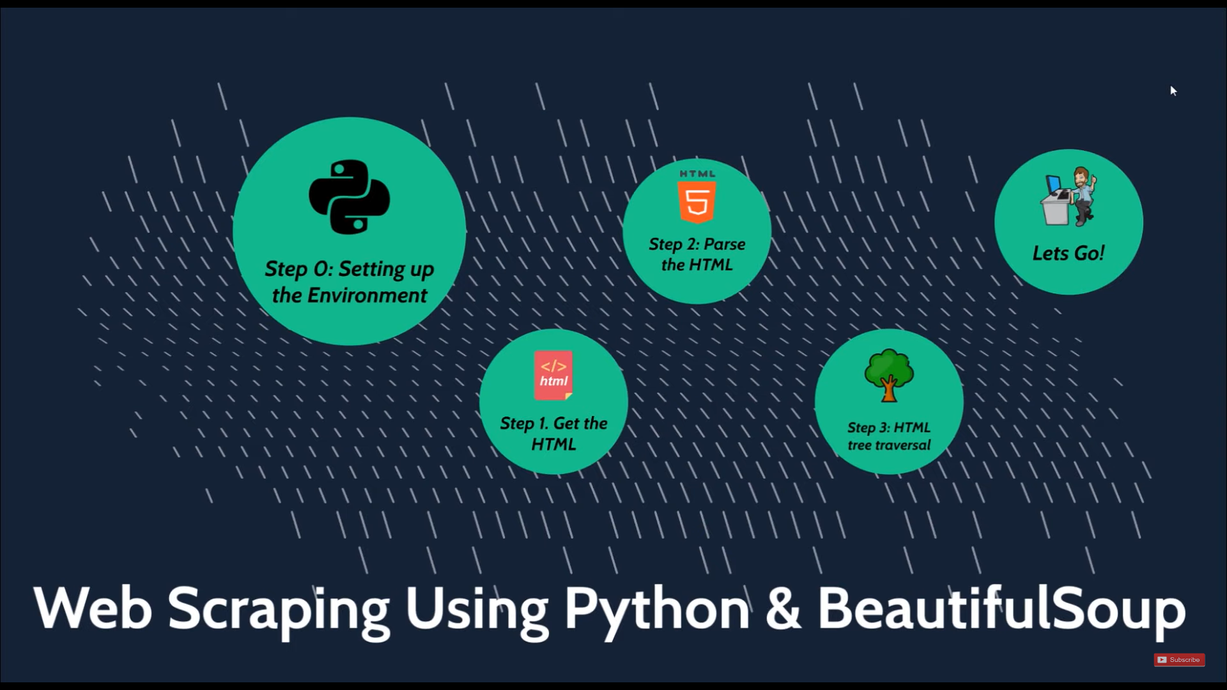

Slide 7
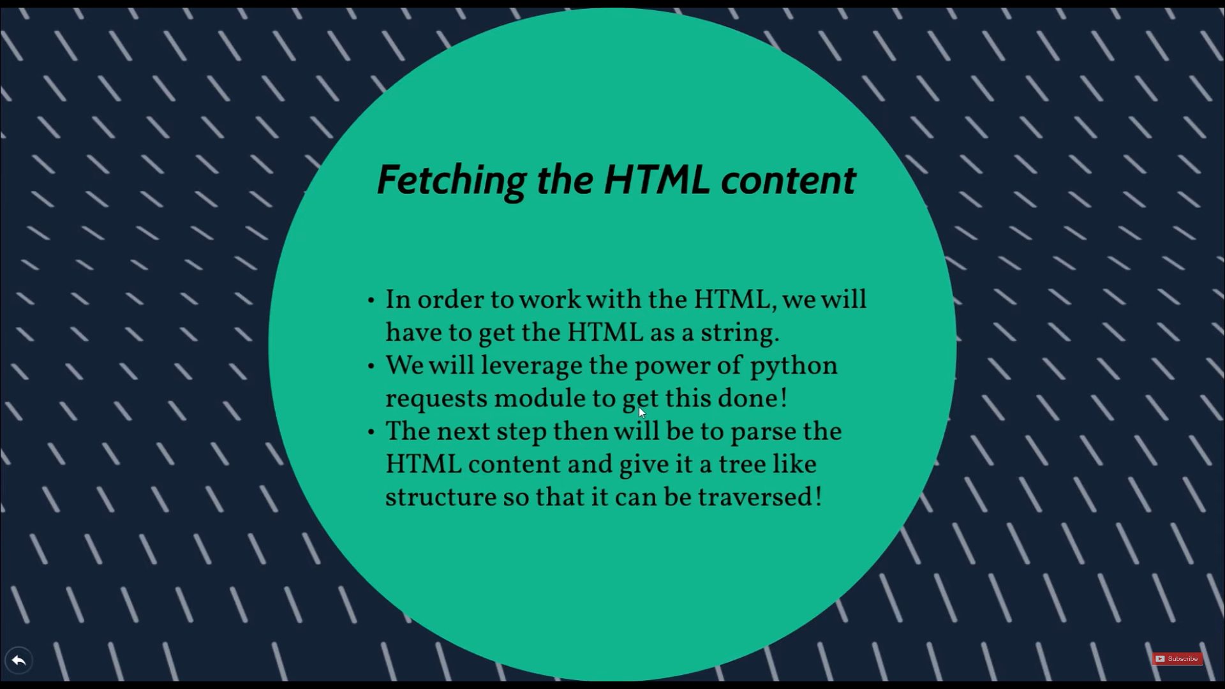

Slide 8
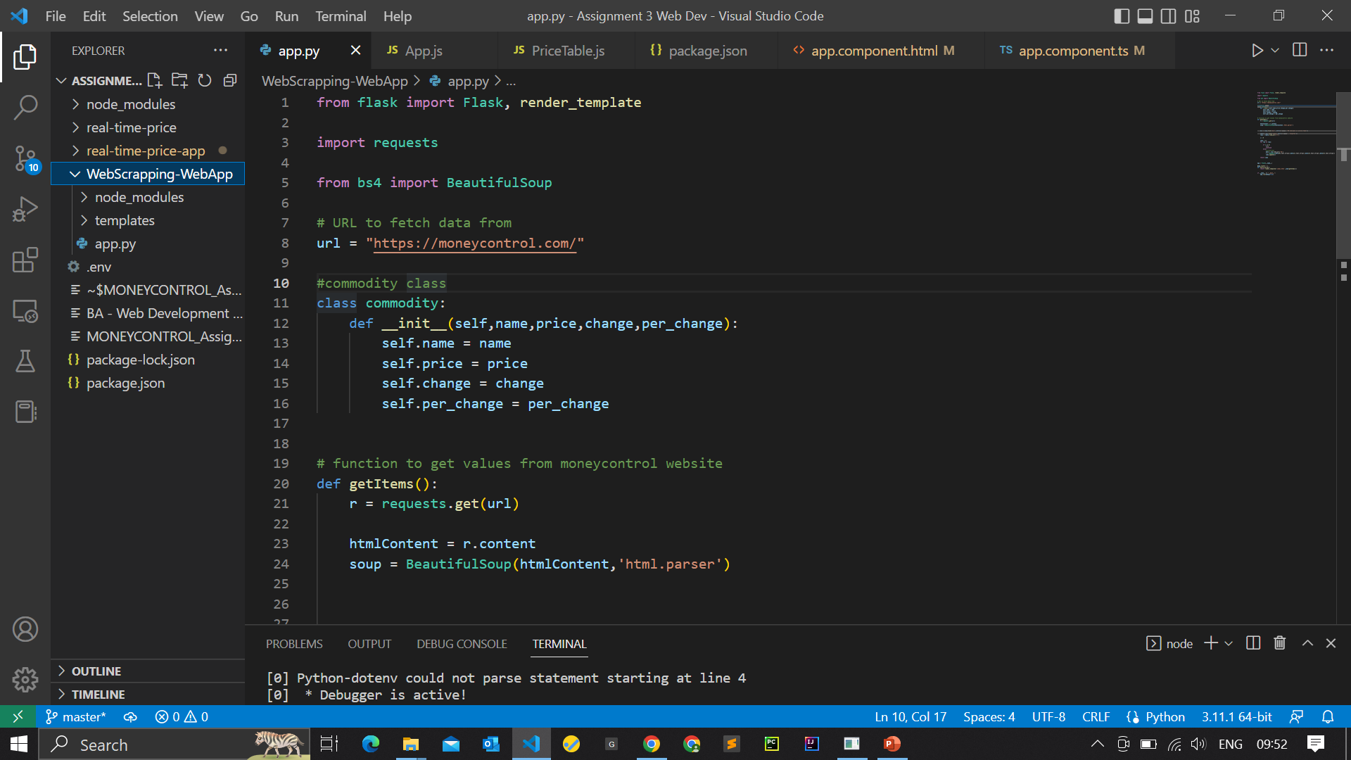
Backend:

Slide 9
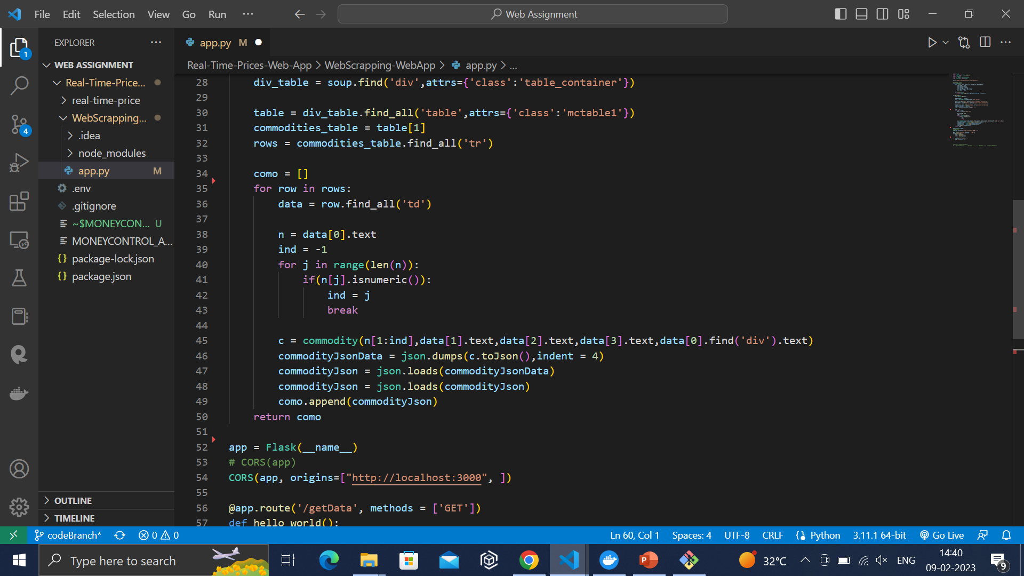

Slide 10
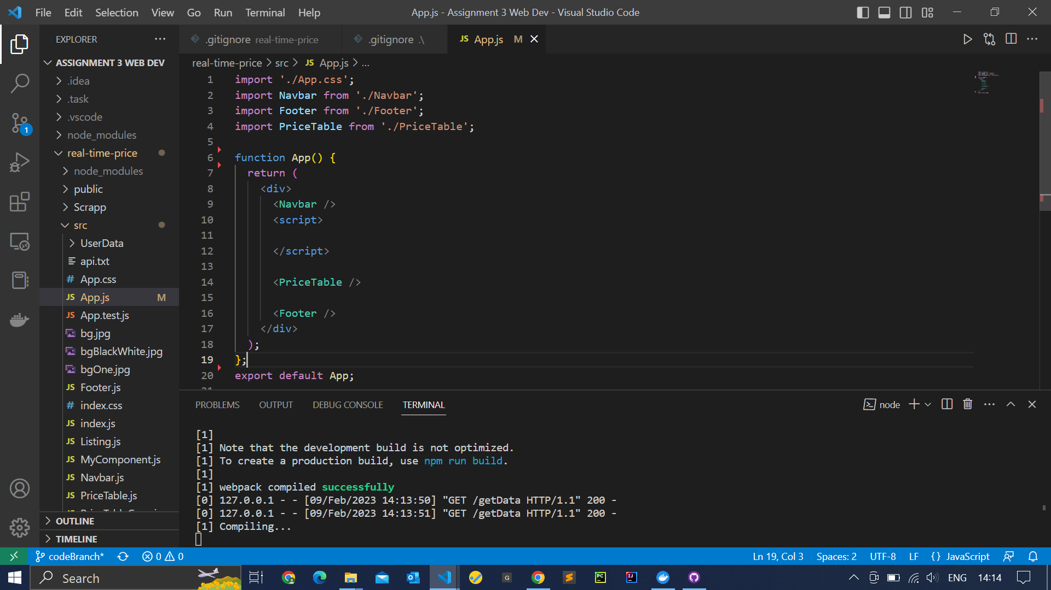
Frontend

Slide 11
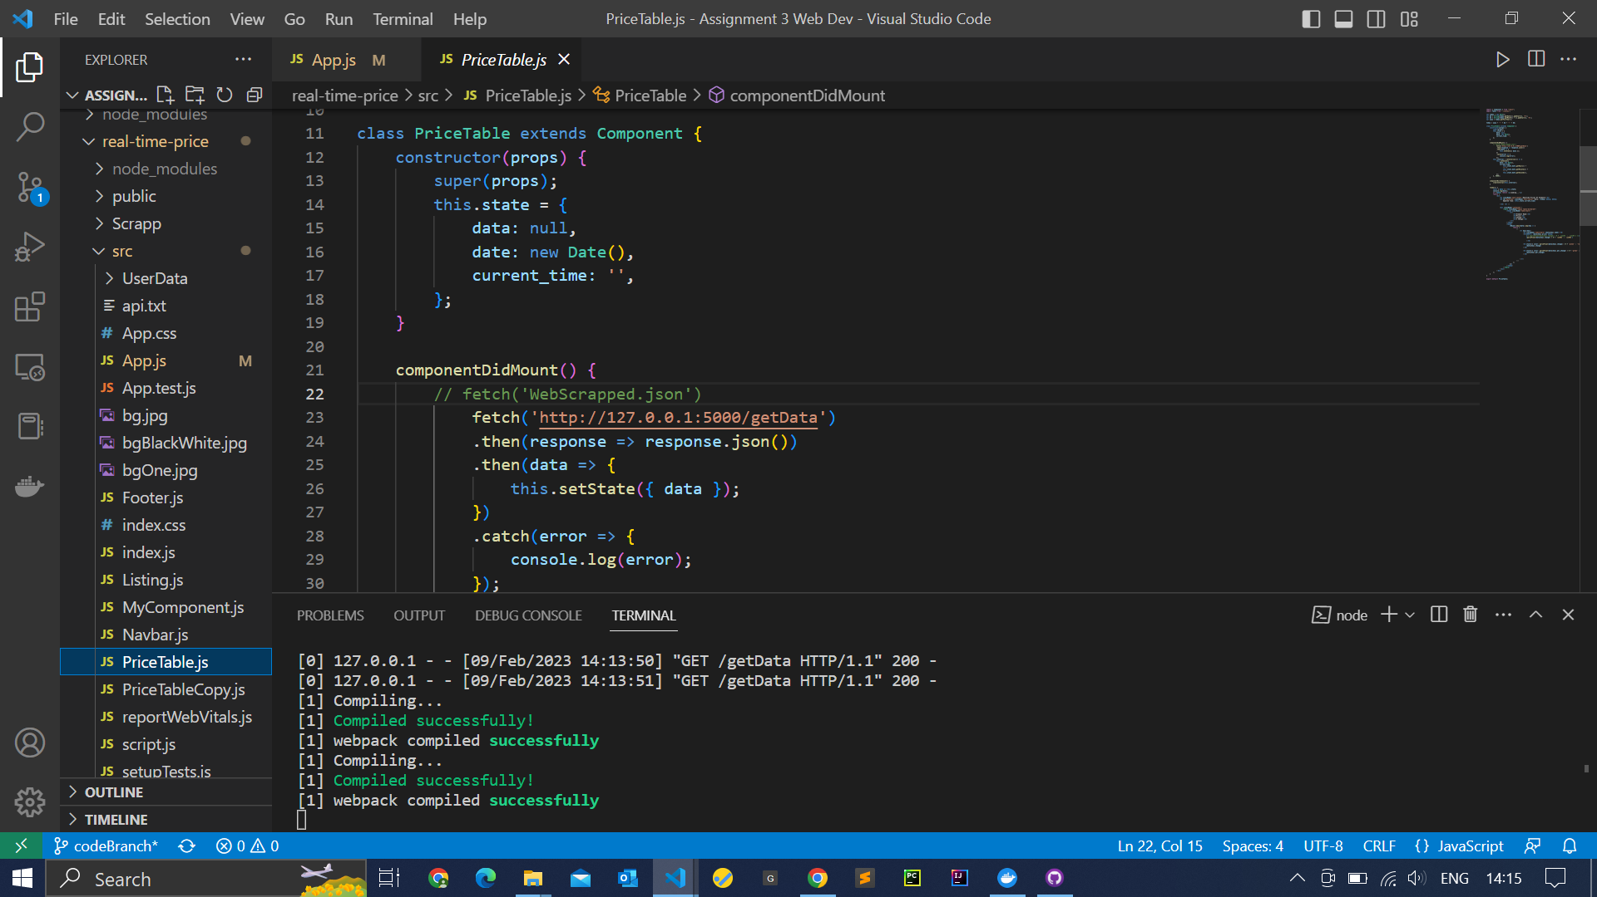
PricaTable.js File

Slide 12
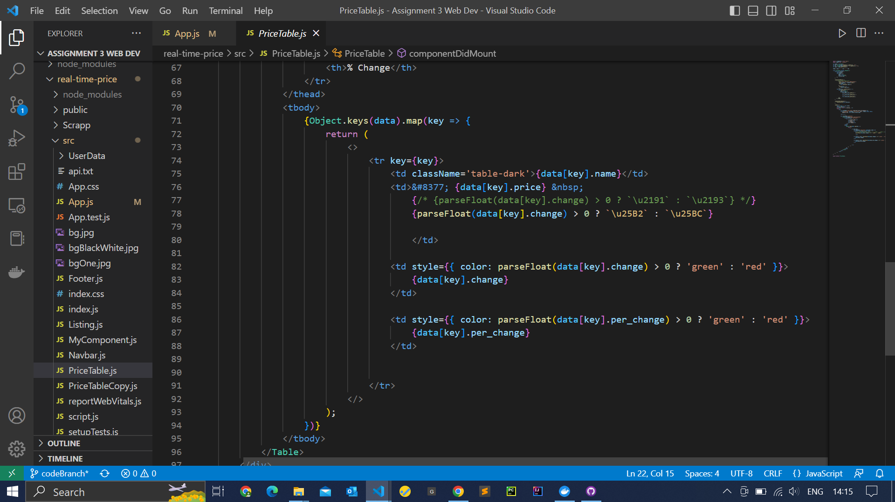

Slide 13
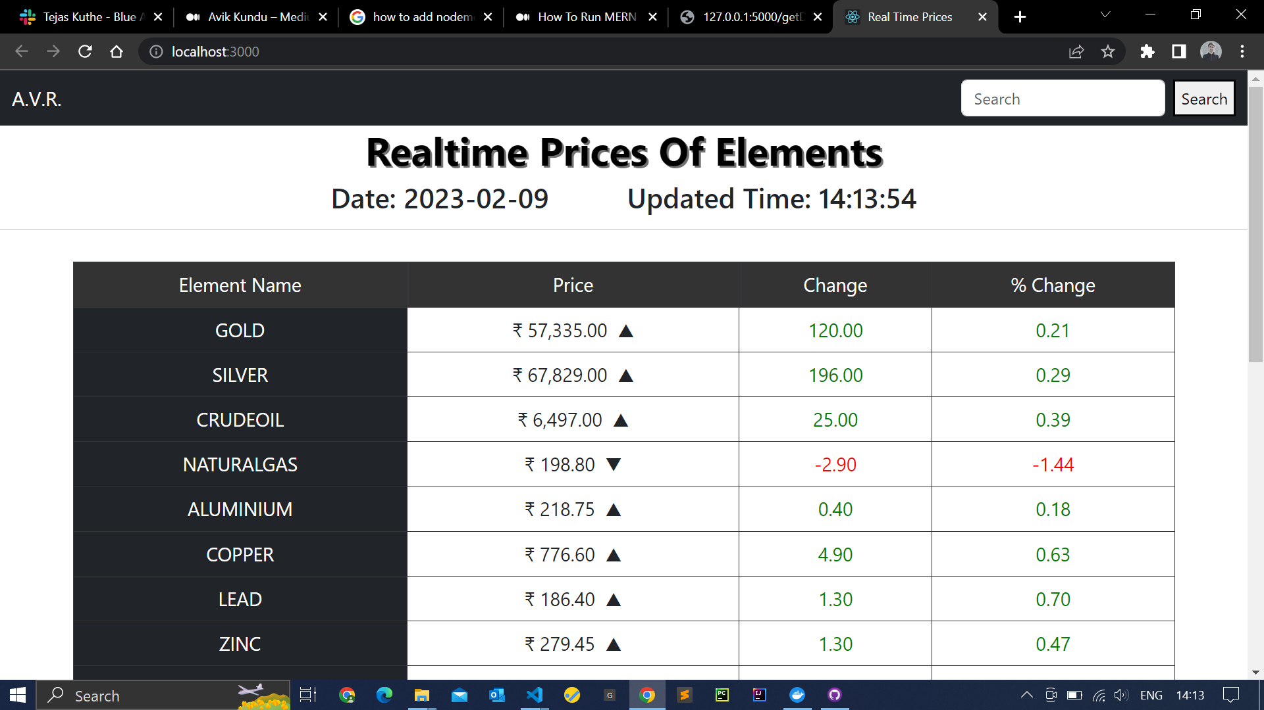

Slide 14
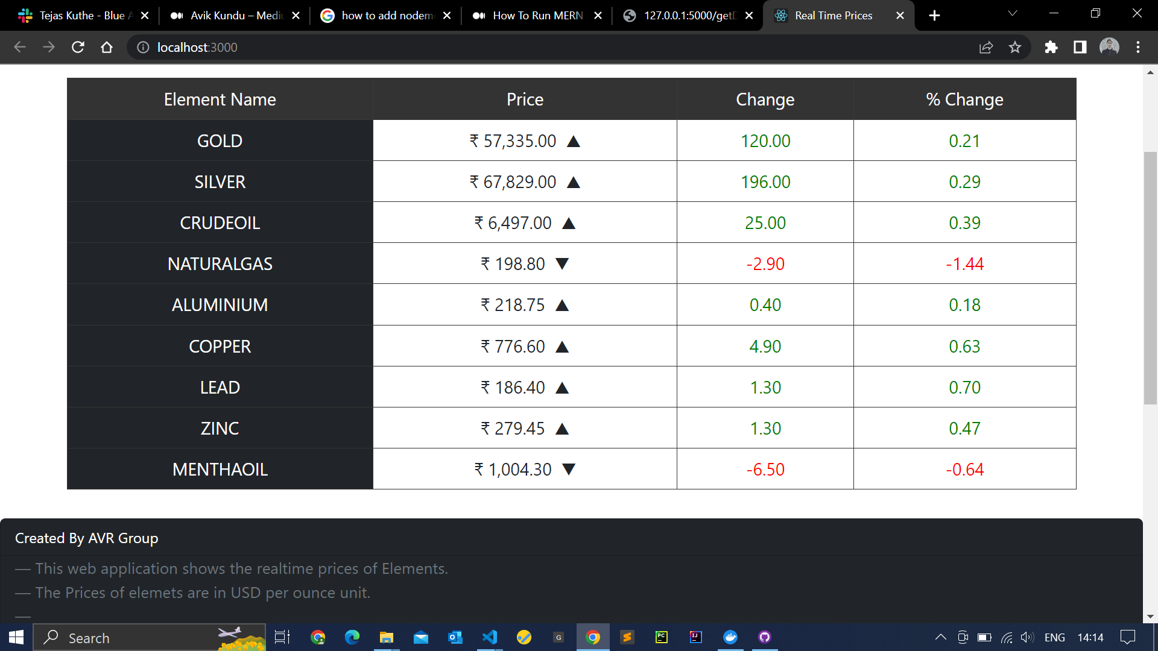

Slide 15
THANK YOU!

